Slide 1
Black Catholic
History Month

Slide 2
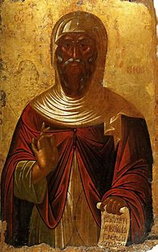
St. Anthony of Egypt- Founder of Christian Monasticism (251-356) Feast Day January 17

Slide 3
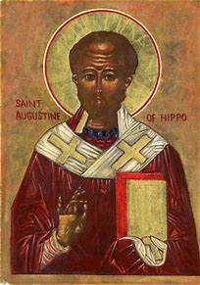
St. Augustine of Hippo, Doctor of the Church (Algeria) (364-430) Feast Day August 28

Slide 4
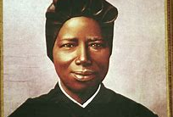
St. Josephine Bakhita- Slave and religious (Darfur, Sudan) (1869-1947) Feast Day February 8

Slide 5
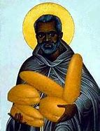
St. Benedict the Moor- Slave and Monk (1526-1580) Feast Day April 4

Slide 6
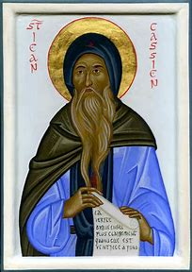
St. Cassian of Tangier- Court Clerk and Martyr (Tangier, Morocco) (d. 298) Feast Day December 3

Slide 7
St. Cyprian of Carthage- Father of the Church, Bishop and Martyr (Tunisia) (ca. 200-258) Feast Day September 16

Slide 8
Pope St. Gelasius I- Forty-Ninth Pope (r. 492-496) Feast Day November 21

Slide 9
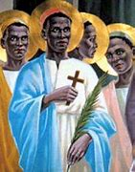
St. Charles Lwanga and Companions-Youth Leaders and Martyrs (Uganda) (1865-1886)
Feast Day June 3

Slide 10
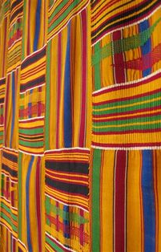
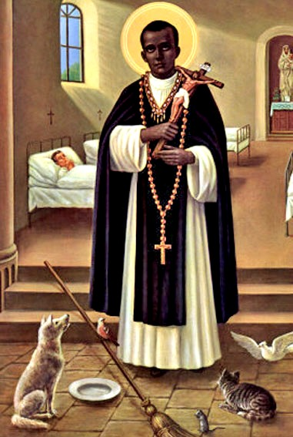
St. Martin de Porres- Lay Brother and Visionary (Lima, Peru) (1579-1639) Feast Day November 3

Slide 11
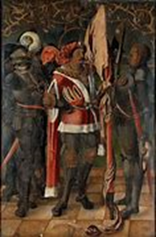
St. Maurice and the Theban Legion- Soldiers and Martyrs (d. 287) Feast Day September 22

Slide 12
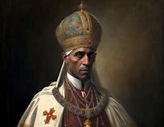
Pope St. Miltiades- Thirty-Second Pope (r ca. 311-314) Feast Day December 10

Slide 13
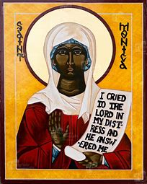
St. Monica- Wife and Mother (331-387) (Algeria) Feast Day August 28

Slide 14
St. Moses the Black- Monk (Egypt) (330-405) Feast Day August 28

Slide 15
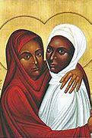
Sts. Perpetua and Felicitas- Noblewoman and her Slave (Tunisia) (d. 203) Feast Day March 7

Slide 16
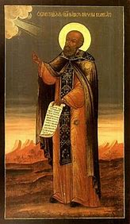
St. Poemen- Monk of Wisdom (Egypt) (Fifth Century) Feast Day August 27

Slide 17
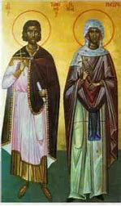
Sts. Timothy and Maura- Married Martyrs (Egypt) (d. ca. 298) Feast Day May 3

Slide 18
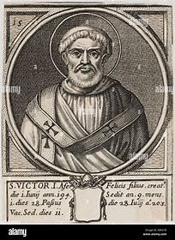
Pope St. Victory I- Fifteenth Pope (r. 189-ca. 198) Feast Day July 28

